Slide 1

OpenShift State of the Union
brought to you by JBoss
Eric D. Schabell
JBoss Technology Evangelist
http://www.schabell.org
@ericschabell / fb:ericdschabell

Slide 2
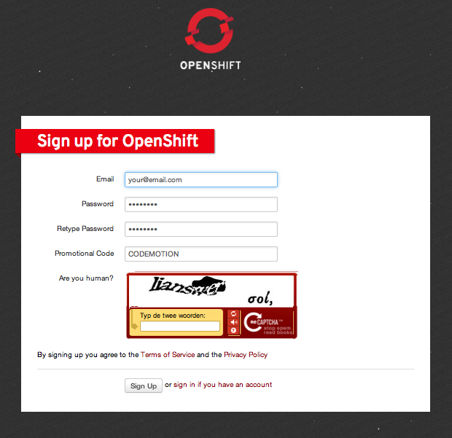
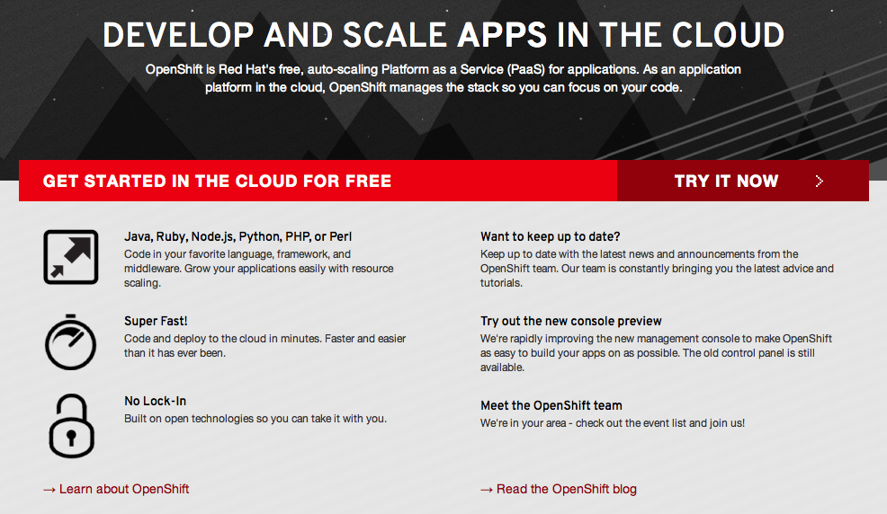
First things first, sign up!
http://openshift.redhat.com
Promotional Code: JUDCON

Slide 3

State of the Union:
“A speech given by the US President to Congress every year describing the condition of the country...”

Slide 4
OpenShift, a little history
Nov 2010 – Makara acquired
In 2011 – merged into OpenShift project
May 2012 – Open Sourced OpenShift
    LiveCD launched for local PaaS
    GitHub code base
    Activity: blogs, howto's, quickstarts, webinars
June 2012 – JBoss World, stay tuned!

Slide 5
JUDCon PaaS Training
Day 1:
  1400 hrs – Mobilize your application using JBoss (Grant)
  1530 hrs – Deployment of JEE6 apps on OpenShift made easy (Xavier)
Day 2:
  1100 hrs – Deploying the JBoss Portfolio in the Cloud (William (aka Bill))

Slide 6

An OpenShift Primer
Get your code into the Cloud!
Book coming soon... DeveloperPress.com!

Slide 7


Slide 8

Never look back...

Slide 9


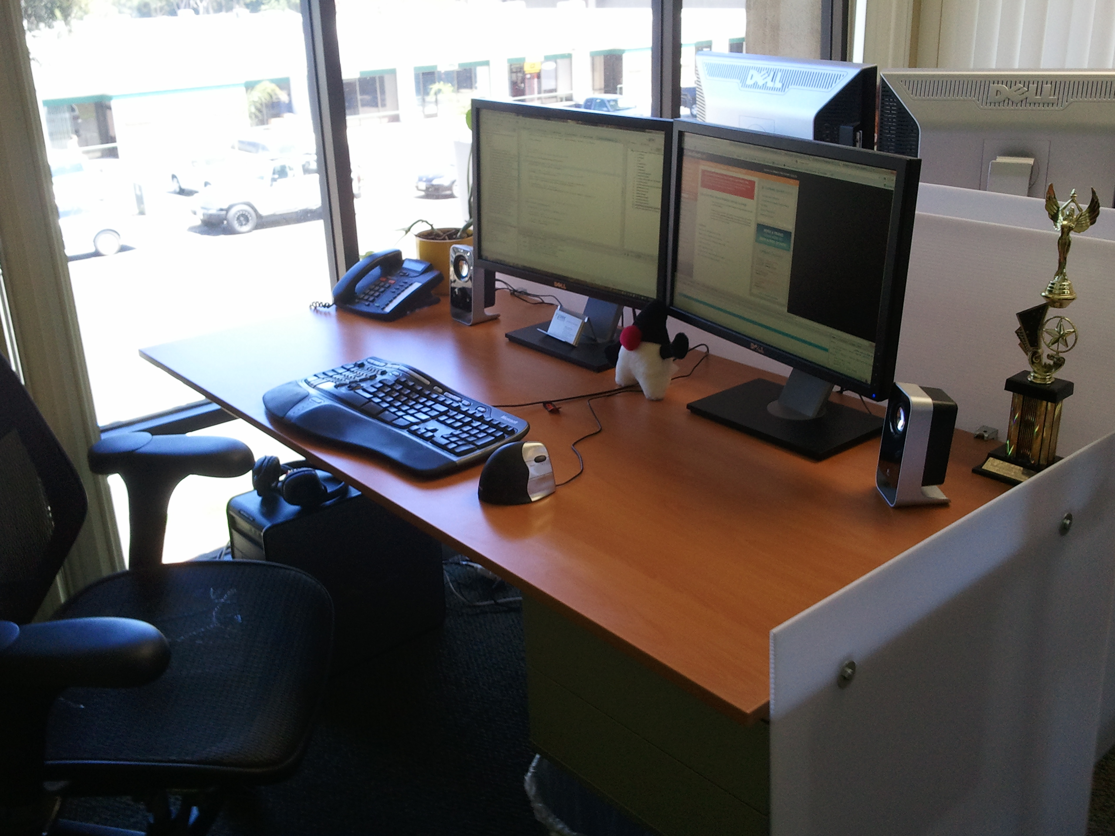
PaaS?

Slide 10

Why am i DORKING
with the stack?!

Slide 11

Quickstart
Sign Up
Install Client Tools
Create Domain
Create Application
Deploy Application (GIT)

Slide 12
Sign up, it's free!
http://openshift.redhat.com – “Sign up and Try it!”
Example projects you can deploy now!
  https://www.github.com/openshift
Help?
  IRC: freenode #openshift
  Forums: http://www.redhat.com/openshift/community/forums
  Email: openshift at redhat dot com
Promotional Code: JUDCON

Slide 13
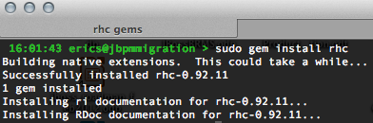
Install Client Tools
Fedora / RHEL
  openshift.repo
Move to yum.repos.d
$ sudo mv openshift.repo /etc/yum.repos.d
Install client tools
$ sudo yum install rubygem-rhc
The rest (osX, Ubuntu, Cygwin):
  gem install rhc (json_pure)
  see forums, blogs

Slide 14
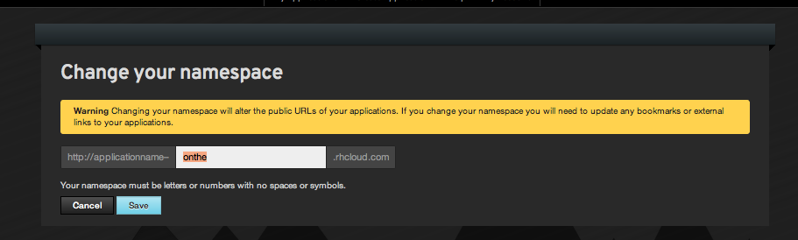
Create Domain
Use rhc command
  $ rhc domain create -n mydomain -l openshiftlogin
Use admin console!

Slide 15
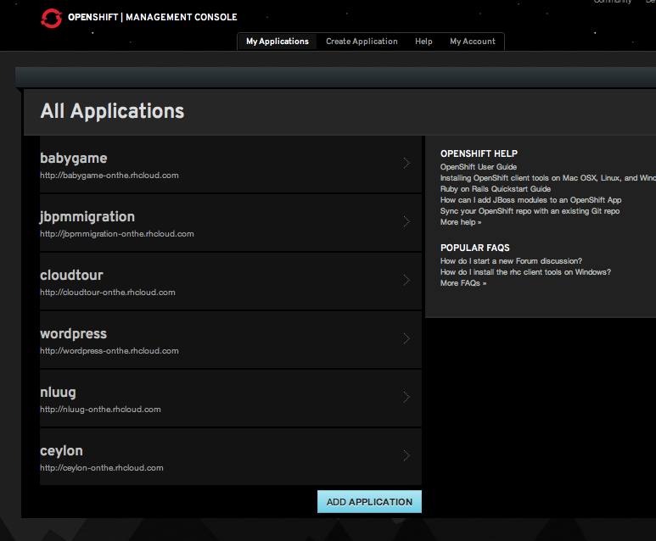
Web Administration

Slide 16
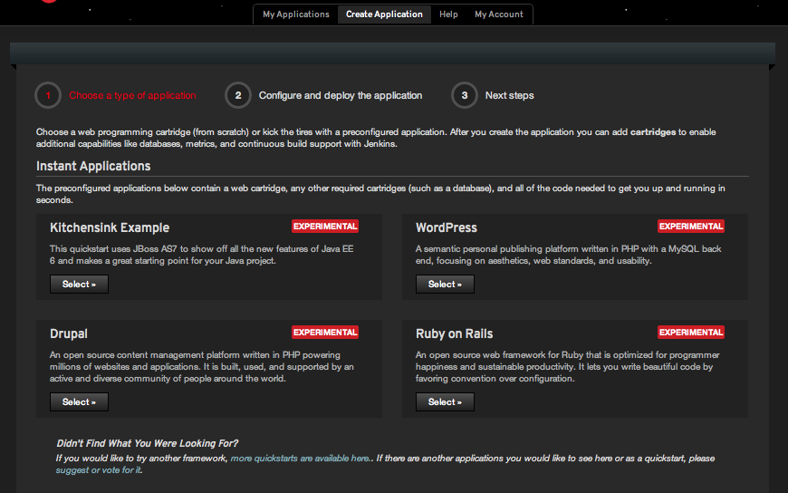
Instant Applications

Slide 17
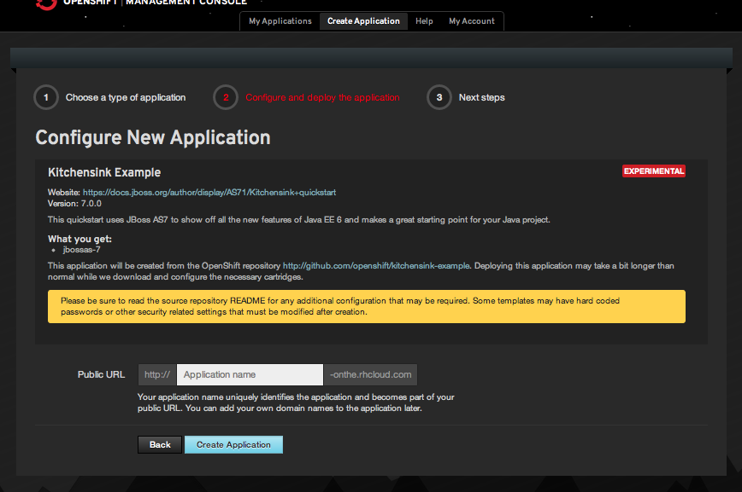

Slide 18
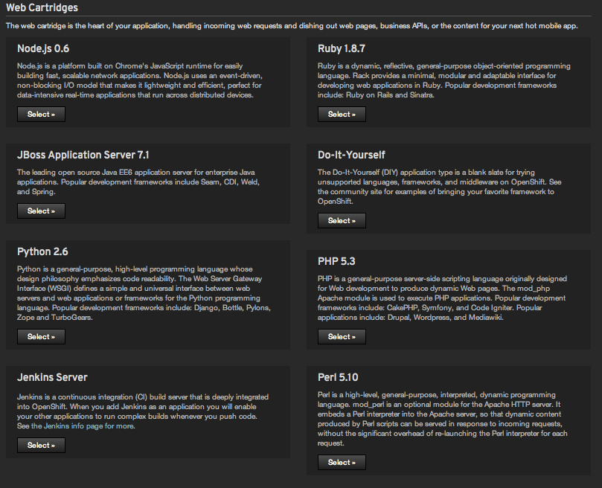

Slide 19
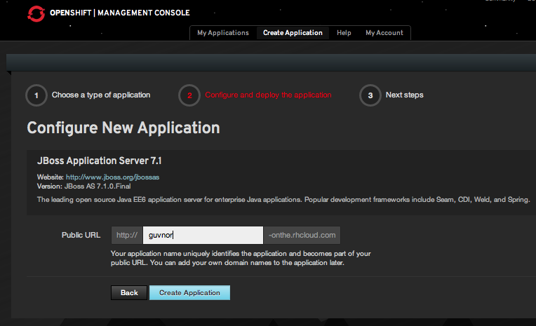
Configure Application

Slide 20
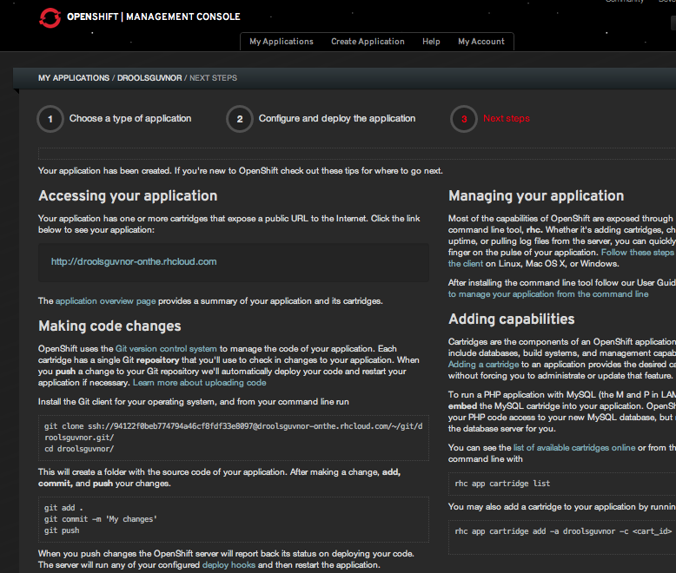
Ready to code!

Slide 21
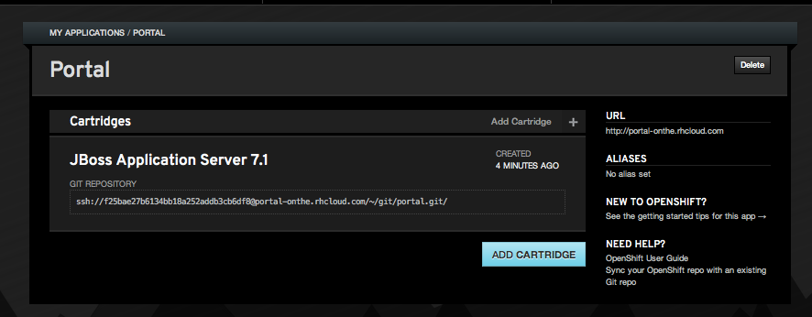
Application Details

Slide 22
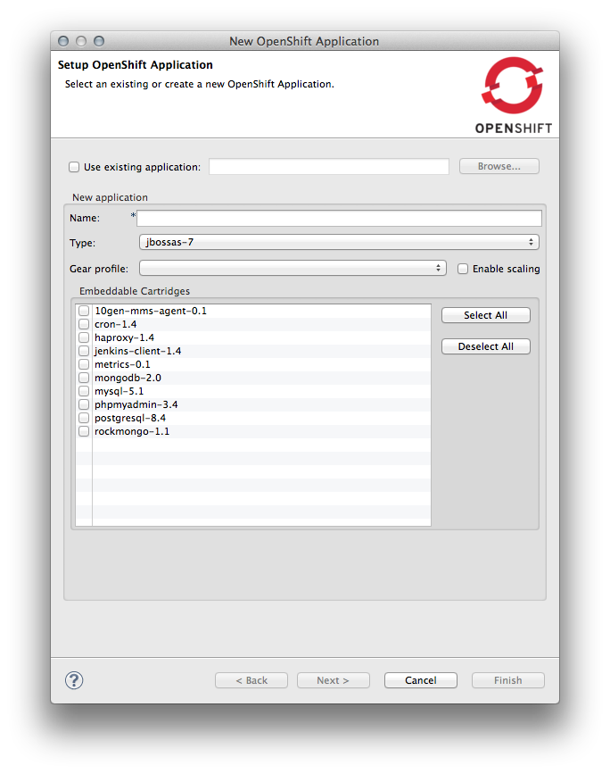
Other Options
Name app and define type
  $ rhc app create -a appname -t apptype -l openshiftlogin
  (Node.js, DIY, Jenkins, PHP, Ruby, Python, Perl and most important, Java!)
Add application to local repo
  $ git add .
Commit changes
  $ git commit -m “Initial app import.”

Slide 23
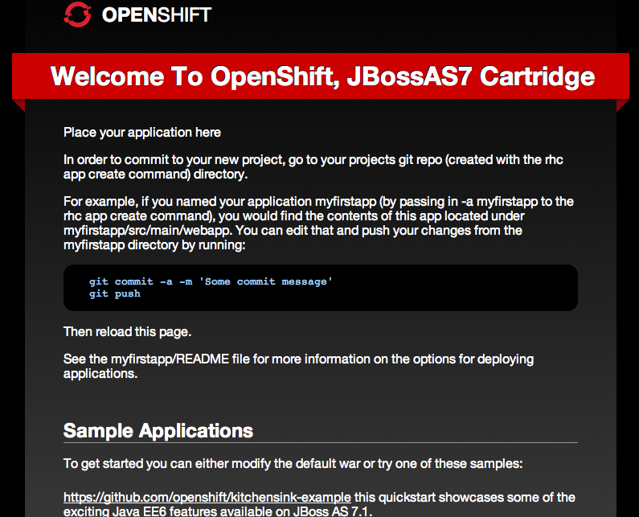
Deploy to Cloud
Push the code to Express
  $ git push
Congratulations, your app is in the cloud!

Slide 24


Slide 25

Gears
500MB memory + 1GB storage

Slide 26
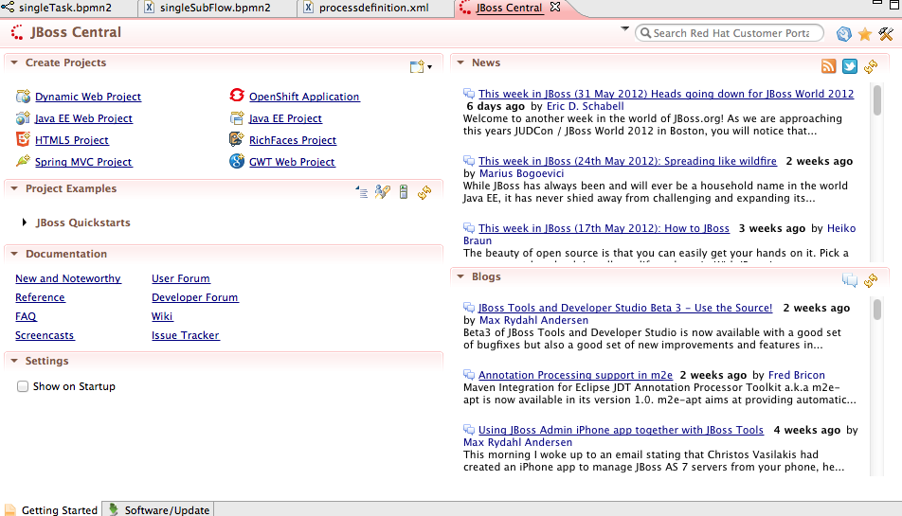
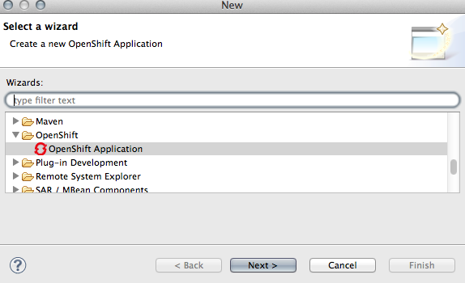
JBoss Developer Studio

Slide 27

Demo JUDCon Mobile App
$ rhc app create -a judcon -t jbossas-7
$ cd judcon
$ git remote add upstream -m master git://github.com/eschabell/openshift-judcon.git
$ git pull -s recursive -X theirs upstream master
$ git push
http://judcon-$your_domain.rhcloud.com

Slide 28
Demo Drools Guvnor
$ rhc app create -a droolsguvnor -t jbossas-7
$ cd droolsguvnor
$ git remote add upstream -m master git://github.com/eschabell/openshift-droolsguvnor.git
$ git pull -s recursive -X theirs upstream master
$ git push
http://droolsguvnor-$your_domain.rhcloud.com:8080/guvnor-webapp

Slide 29

Demo jBPM Web Designer
$ rhc app create -a editor -t jbossas-7
$ cd editor
$ git remote add upstream -m master git://github.com/eschabell/openshift-webdesigner-jbpmmigration.git
$ git pull -s recursive -X theirs upstream master
$ git push
http://editor-$your_domain.rhcloud.com/designer/editor?profile=jbpm&uuid=123

Slide 30
Demo jBPM Migration Project
$ rhc app create -a jbpmmigration -t jbossas-7
$ cd jbpmmigration
$ git remote add upstream -m master git://github.com/eschabell/openshift-jbpmmigration.git
$ git pull -s recursive -X theirs upstream master
$ git push
http://jbpmmigration-$your_domain.rhcloud.com/jbpmmigration_upload-0.4

Slide 31
Demo Switchyard Project
$ rhc app create -a swyesb -t jbossas-7
$ cd swyesb
$ git remote add upstream -m master git://github.com/eschabell/switchyard-openshift.git
$ git pull -s recursive -X theirs upstream master
$ git apply standalone.diff
$ git push
http://swyesb-$your_domain.rhcloud.com/swydws/OrderService?wsdl

Slide 32

Demo Ceylon Project
$ rhc app create -a ceylon -t jbossas-7
$ cd ceylon
$ git remote add upstream -m master git://github.com/eschabell/ceylon-openshift.git
$ git pull -s recursive -X theirs upstream master
$ git push
http://ceylon-$your_domain.rhcloud.com

Slide 33
Demo GateIn Project
$ rhc app create -a portal -t jbossas-7
$ cd portal
$ git remote add upstream -m master git://github.com/eschabell/openshift-portal.git
$ git pull -s recursive -X theirs upstream master
$ git push
http://portal-$your_domain.rhcloud.com/portal

Slide 34
Demo Drools Planner
$ rhc app create -a droolsplanner -t jbossas-7
$ cd droolsplanner
$ git remote add upstream -m master git://github.com/eschabell/openshift-droolsplanner.git
$ git pull -s recursive -X theirs upstream master
$ git push
http://droolsplanner-$your_domain.rhcloud.com/droolsplanner

Slide 35

What will the future bring?
JBoss++
Commercial Service / Pricing
Mobile
Open Source (SDK + project)
2012

Slide 36




Loving your hammers?

Slide 37

OpenShift: http://openshift.redhat.com
OpenShift Express: https://openshift.redhat.com/app/express
Blogs: https://www.redhat.com/openshift/community/blogs
Repository for all OpenShift demos shown here: https://github.com/eschabell
OpenShift demo repository: https://github.com/openshift
Rise above the Cloud hype with OpenShift: http://www.schabell.org/2012/01/rise-above-cloud-hype-with-openshift.html

